Slide 1


Starting an OBI-Based Biobank Ontology October 6th 2014

Slide 2
Biomedical ontologies are a core part of the Semantic Web framework <true> an emerging technology that is proving essential to solving many of the complex challenges in health care and life sciences <true??>.
Why ontology based approach ?
Why OBI-based ?
What are the requisite functionality ?
Sustainable solution ?
Notes:
Is the function of the biobank sample or specimen focused

Slide 3
Impression over the years (maybe with n=1)
The Collaborative Network for Clinical Research on Immune Tolerance (circa 2006)
Clinical trials consortium for diseases associated with immune tolerance
Complete trial management from concept design, protocol writing and review, regulated clinical measures and mechanistic assays
Study design drives operational activities
Ontology for trial definition, assay design and operational execution
The NIAID Integrated Research Facility (IRF)
Preclinical research organization focused on high containment viral research
Research Operation Management System established through the deployment of a collection of specialized COTS solutions
Information integrated via a shared conceptual model

Slide 4
ITN Charter KB Project (2002)
The ITN was established with the specific intent to create a means of sharing and distributing knowledge amongst experts of various disciplines for the discovery of mechanisms and proposing clinical interventions in the area of immune tolerance.
The power and value of these diverse perceptions, experiences and expertise, would be lost if the first step is to derive consensus on all concepts and interpretations.
So we have taken an approach a bottom up approach that begins with a very granular, loosely structured data and add structure as information are aggregated.
These systems have taken on a knowledge management (KM) approach where elements and relationships are defined and used to describe a clinical trial and associated assays during the protocol creation and review.
The user (study and assay designers) will extend or refine specialized ontologies based on the study idiosyncrasies and capture the metadata generated, we believe our approach will support both internal analytical and workflow requirements as well as integration with external resources.
Notes:
The collective view of the ITN at that time ..
#2 defined the real hurdle and # 3 allowed us to kick the issue down the road

Slide 5
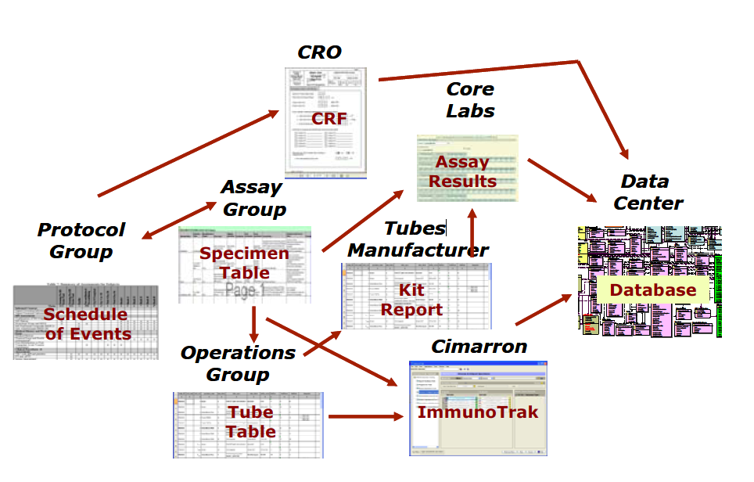
ITN- Stakeholders and Information Artifacts
Notes:
Stake holders and information artifacts

Slide 6
ITN- Concept Models
Schedule of
Activities
Encounter
Activity
Clinical
Ontology
Clinical
Trial
Ontology
Assay
Ontology
Assay
Specimen
Processing
Plan
Specimen
Container
Set
Labware
Ontology
Virtual
Trial
Record
Constraint
Expression
Ontology
Specimen
Workflow
Organization
Ontology
Measurements
Ontology

Slide 7
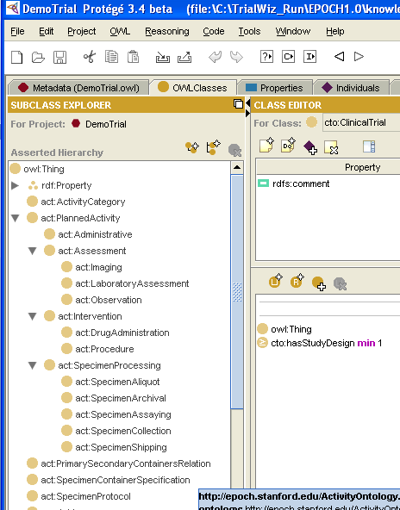
ITN- Epoch ontology
Library of Ontologies
Act: Activities
Org: Organization
Assay: Assay
Con: Constraint
Mes: Measurement
Lab: labware
CTO: Clinical Trials

Slide 8
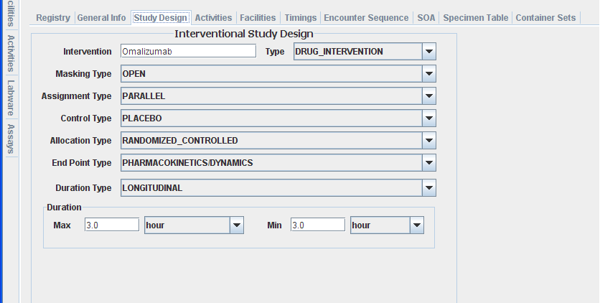
ITN- Trial Wizard
Notes:
Ontologies are the elevators

Slide 9
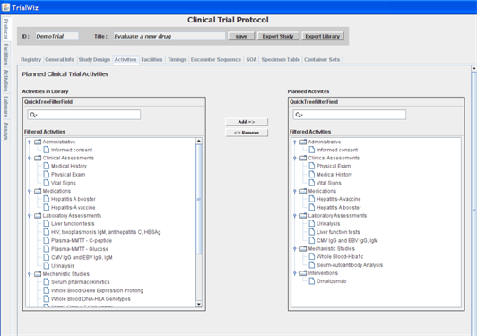
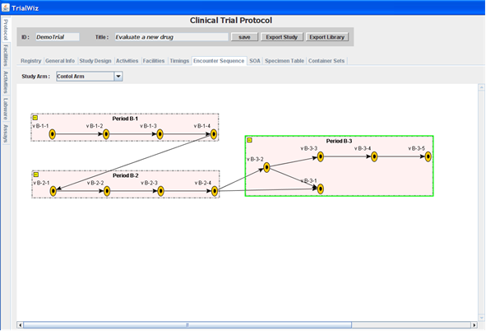
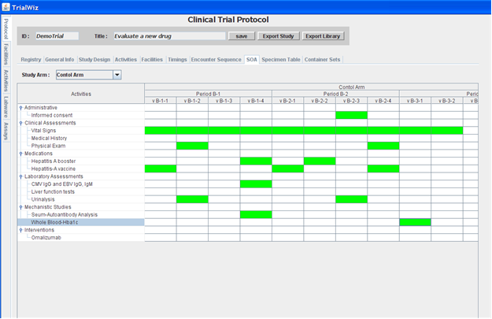
ITN- Trial Wizard
Notes:
Ontologies are the elevators

Slide 10
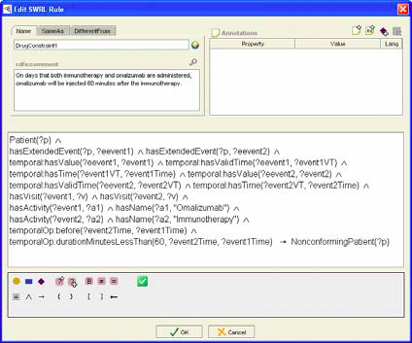
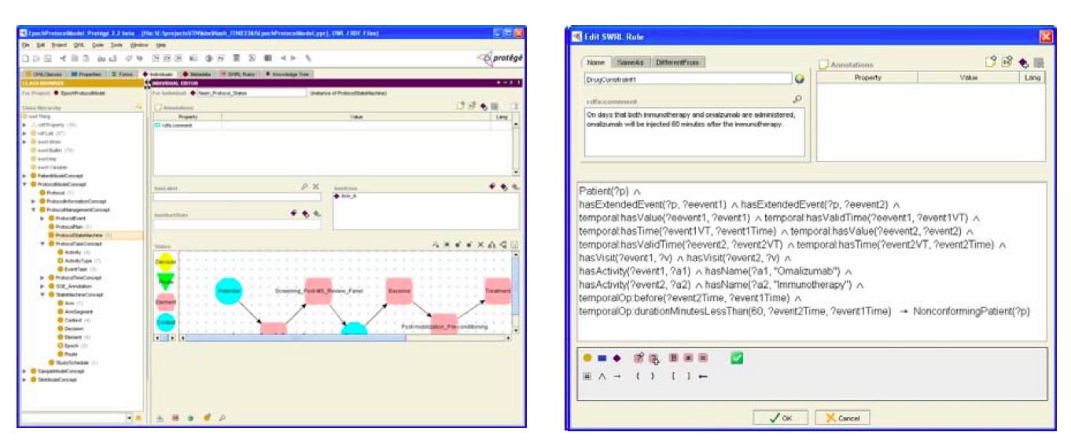
Constraining Rules

Slide 11
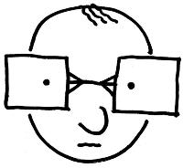
The Study Designer at the ITN
Knowledge Representation
Knowledge
Specification
Knowledge Acquisition
Concepts
Knowledge Acquisition
Structure
Data
Content
Expert
Data
Representation
Data Value Set
Specification
Notes:
Constrain and assign

Slide 12
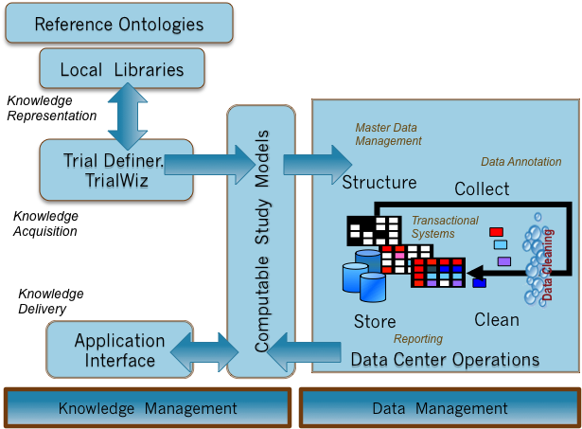
The Study Designer at the ITN
Study.owl and
Model Database Mapper

Slide 13
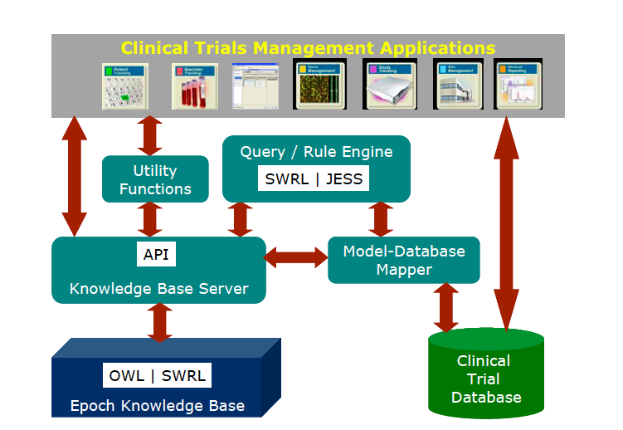
Building applications to make use of the Study.owl
Notes:
Ontologies are the elevators

Slide 14
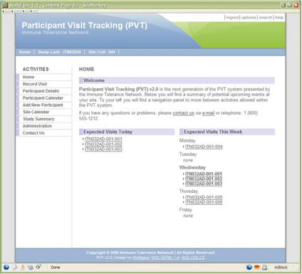
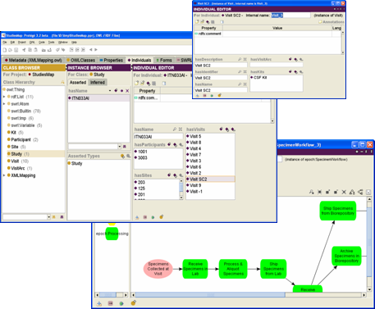
Using Reasoning Services to Determine a Participant’s next visit
2. Participant Tracking queries the Epoch Knowledge base Services on a participant’s next visit
1. PVT stores patient event data
1
Data
Collection
4
Epoch
Knowledge base
Services
2
Participant Visit Tracking
4. Reasoning Services interpret protocol knowledge with trial data to answer the question
ITN Clinical Trial
Database
3. Virtual Trial Record in the Epoch ontologies is mapped to appropriate participant data
Epoch Clinical Trials
Knowledge base
3
Ontology-Database
Mapping

Slide 15
Lesson Learned
This is complex – requires organizational mandate that is based on realistic plans and expectations with the understanding of both the real value proposition and initial overhead
Objectives defined for ITN
Data Sharing
System Interoperability
Long-term Extensibility
The defined objectives and organization patience drove how the ontologies were leveraged

Slide 16
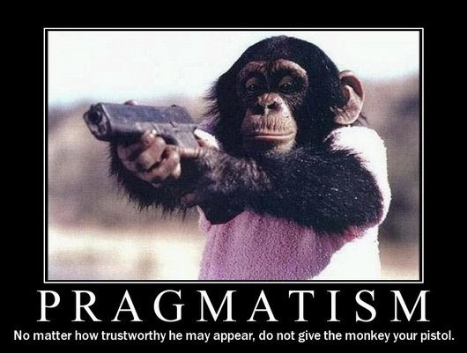
Vision vs. Practice

Slide 17
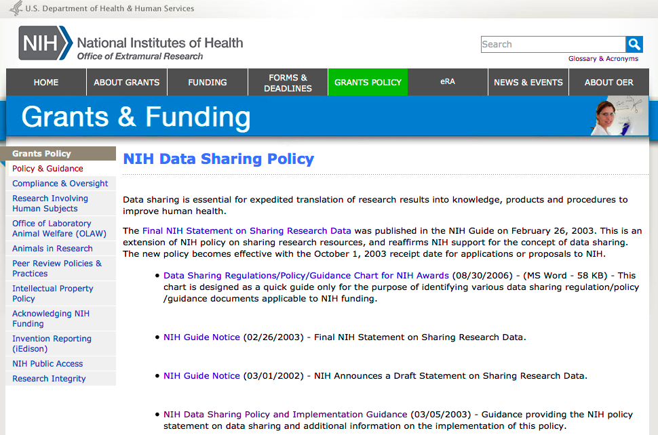

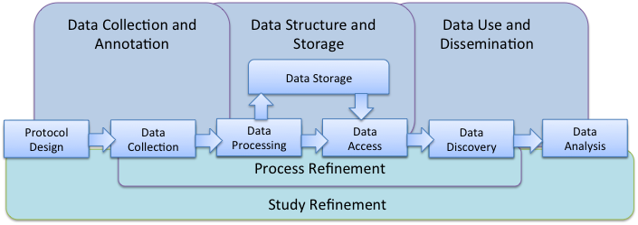
Data Sharing

Slide 18
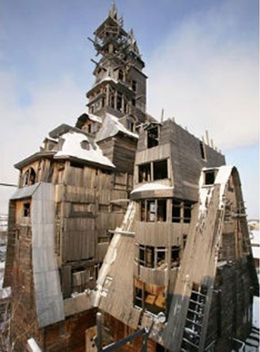
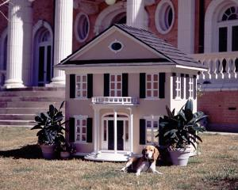
System integration
“Don’t build a dog house more valuable than your dog”
“you can’t build a skyscraper by nailing 1000 doghouses together”
Grady Booch
Notes:
Goals establishing a framework or a systems based approach
Model a formal computable representation of a real world scenario
---unified modeling language.. Levels of abstraction

Slide 19
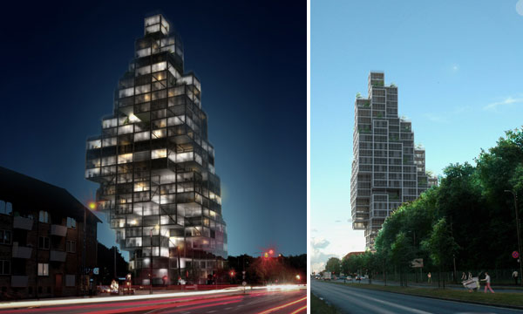
System Integration
Depends on what you nail them to …..
Notes:
OBO foundation

Slide 20
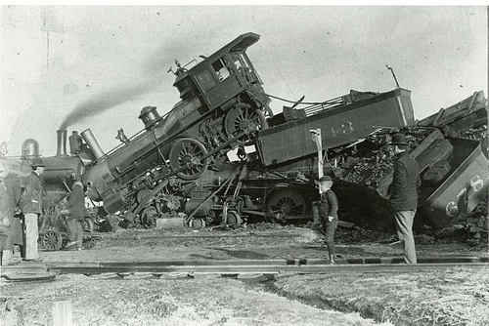
Long-Term Extensibility (proprietary vs. open )
More about community than technology

Slide 21

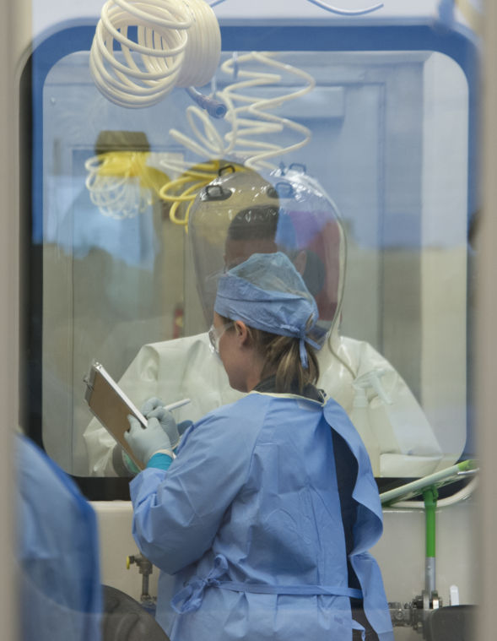
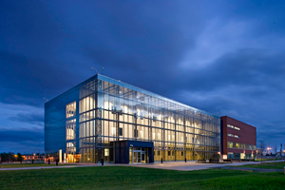
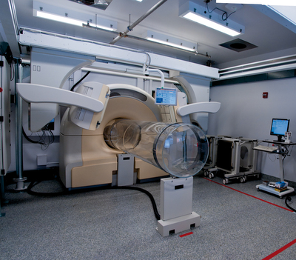
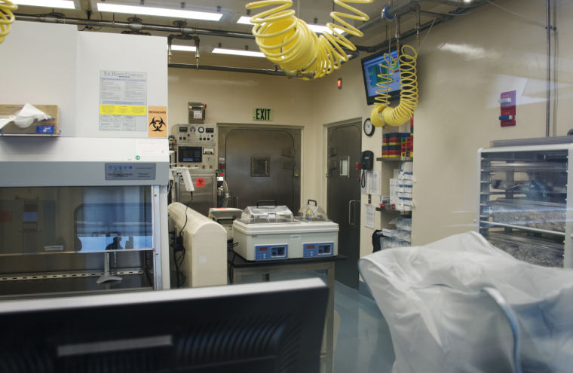

NIAID Integrated Research Facility

Slide 22
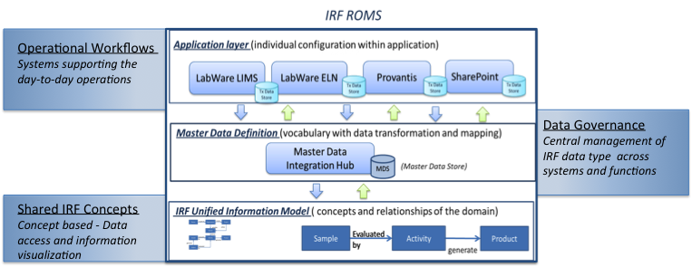
IRF creating a unified model of the research concepts
Research Designer Application
Notes:
Currently backwards in the LIMS then to a unified model

Slide 23
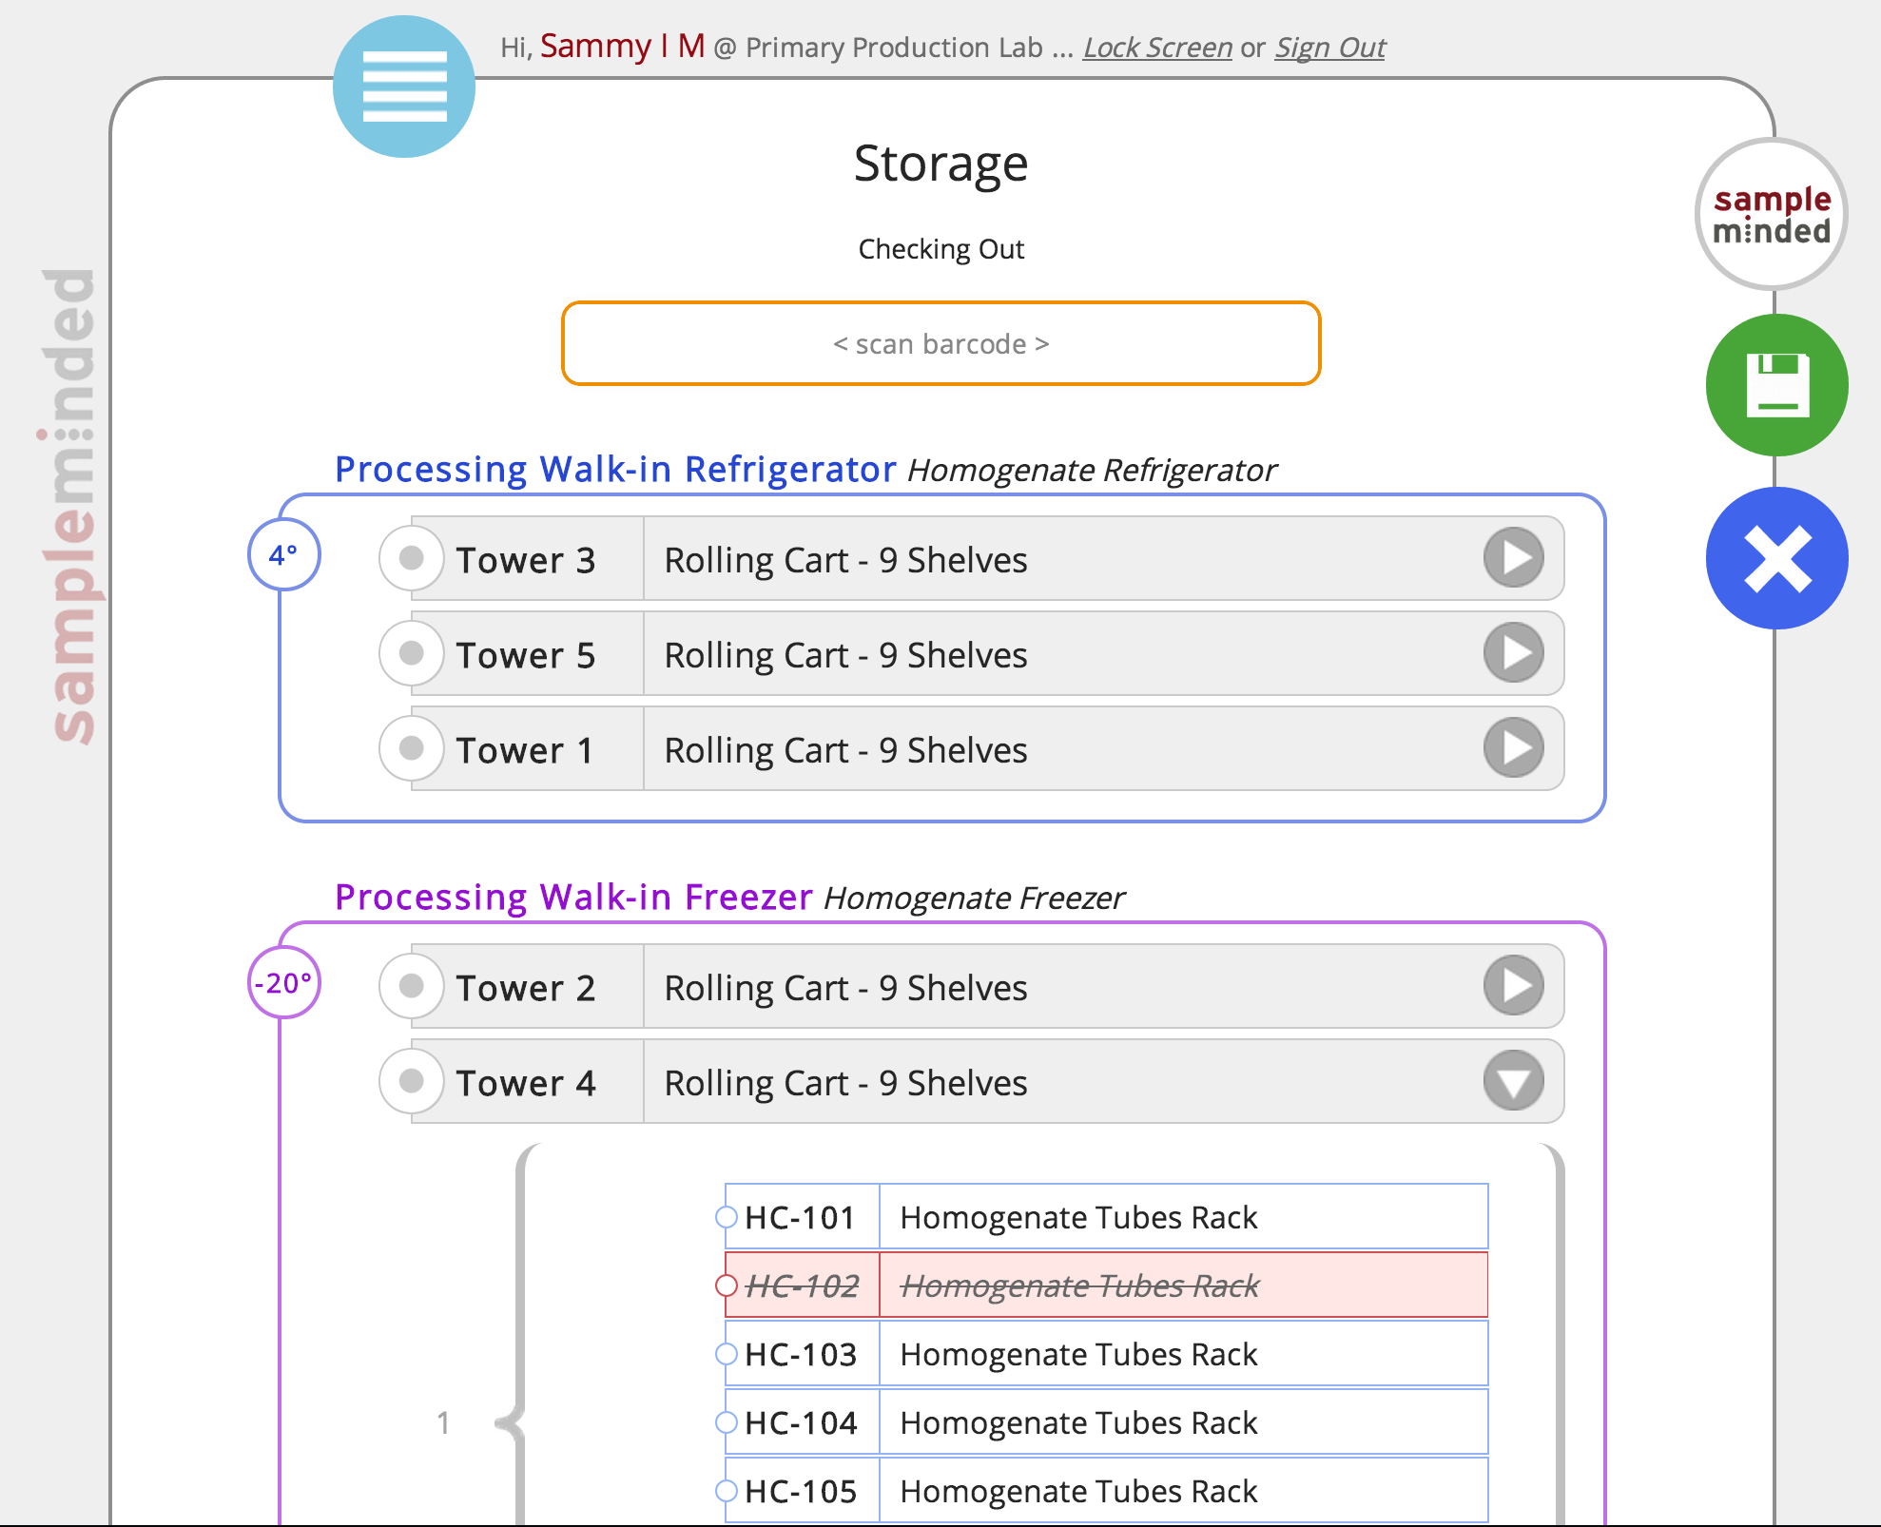
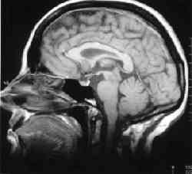
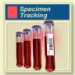
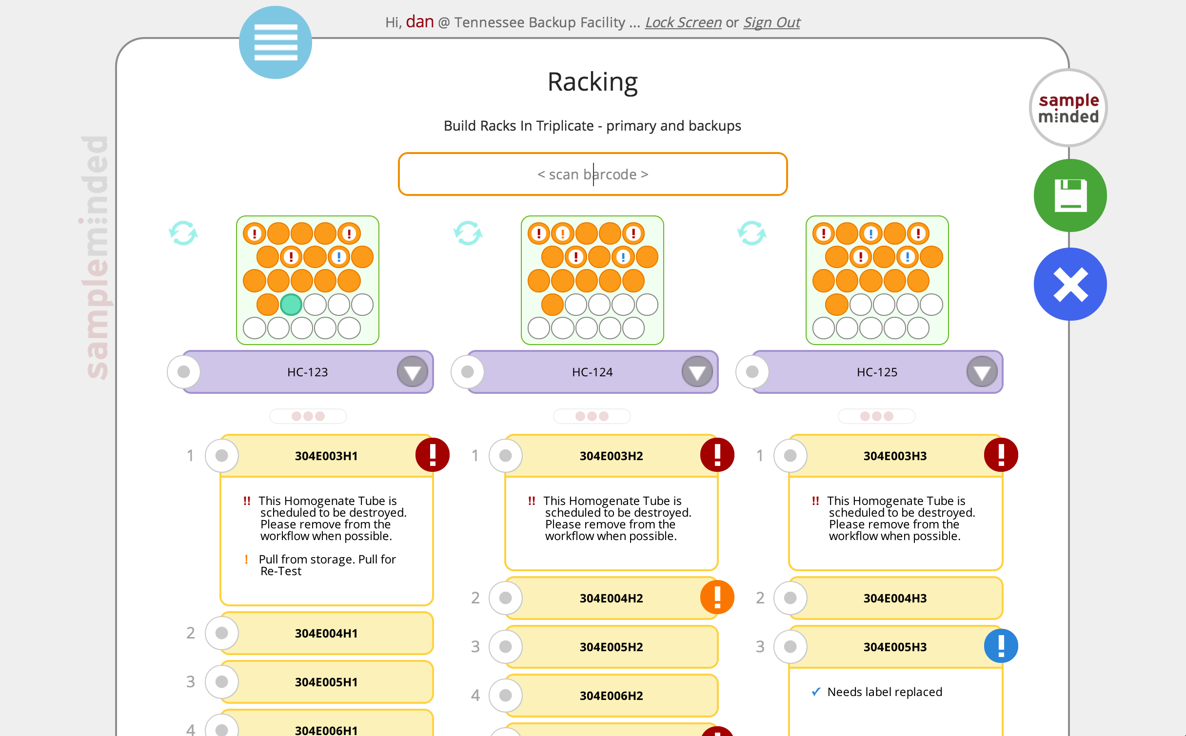
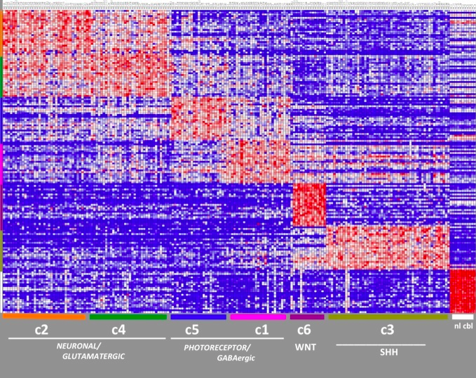
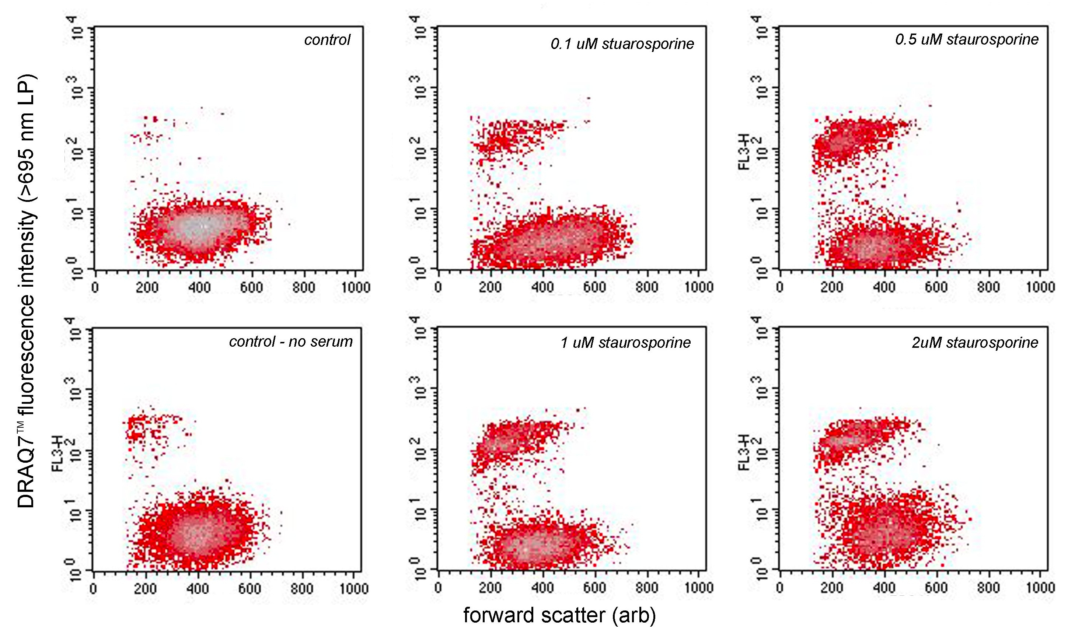
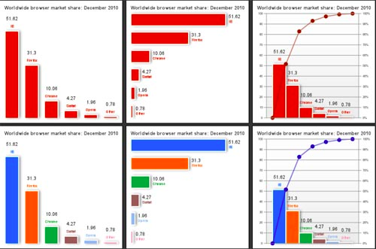
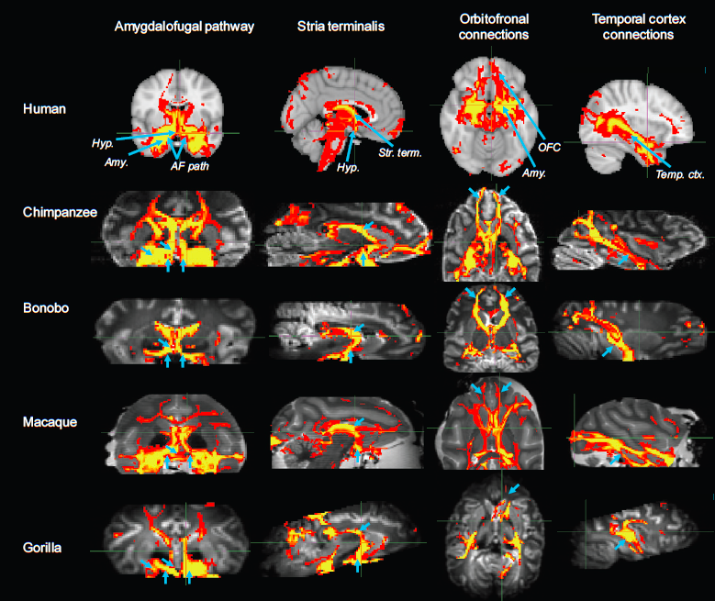
oh yea …biobanking
In both systems samples are characterized and annotated as part of the operational and analytical workflows
Study Subject
Obs-1
Obs-2
Obs-3
Inventory and Location
Management
Pre-trt
Trt
Assay, Observations and interpretation

Slide 24
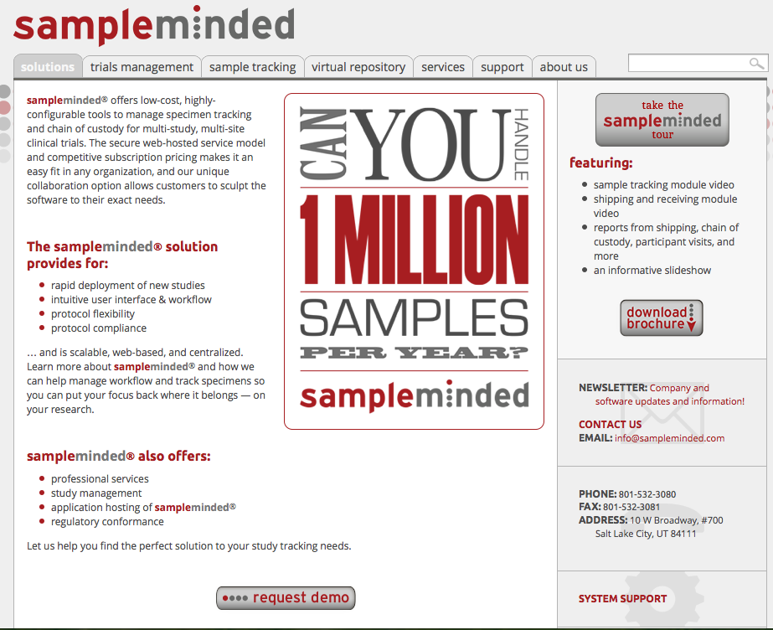
SampleMindedTM system was derived through ITN approach
www.Sampleminded.com

Slide 25
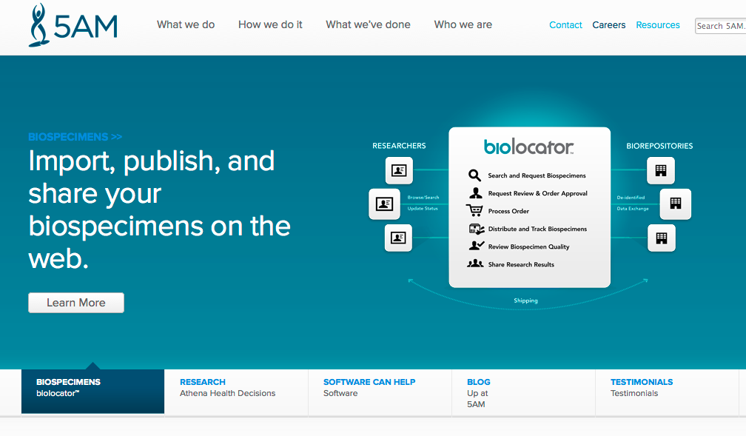
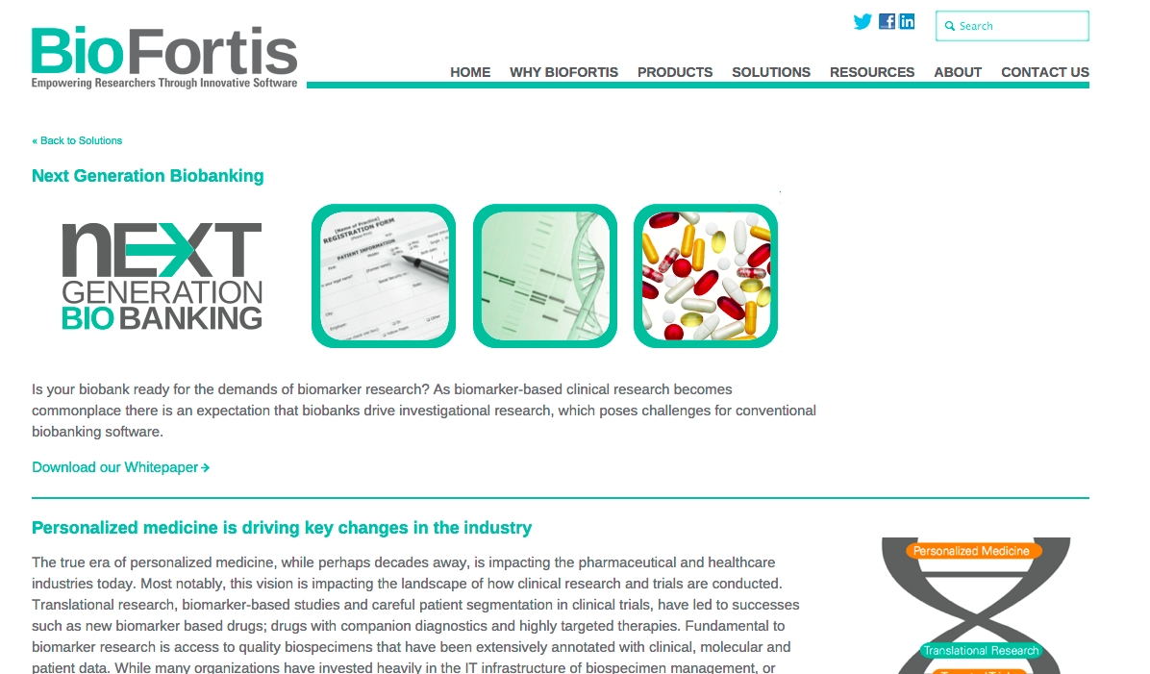
Other Good Work

Slide 26
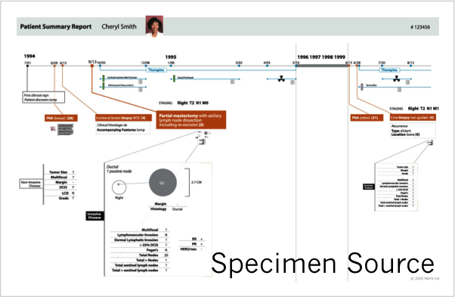
BioBanking application
Assay Development / Biomarker Development
Screen→ Develop →Test → Refine
Validate

Slide 27
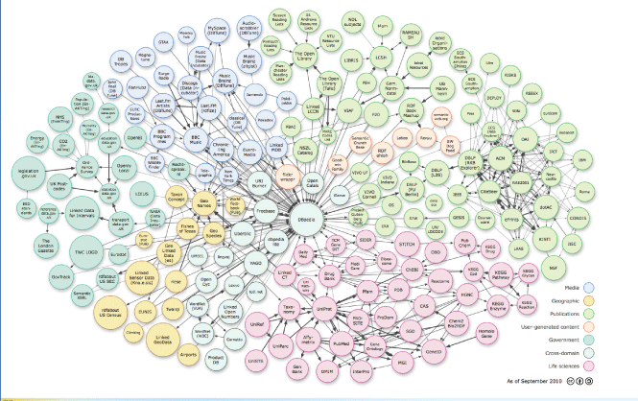
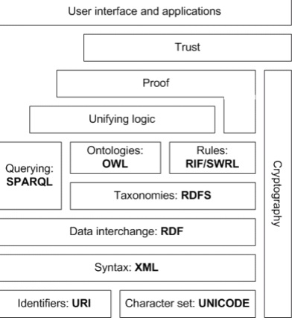
Linked Open Data

Slide 28
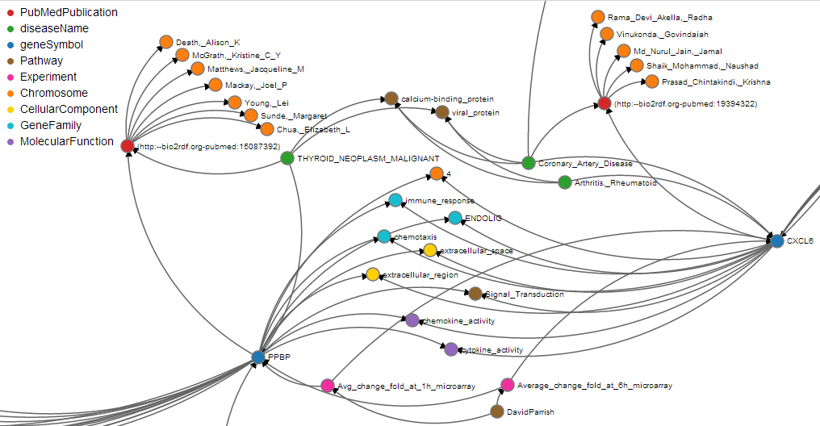
Data Traversing (Ebola Use Case)
Notes:
PubMedPublication – PubMed
diseaseName/ diseaseClass – DisGeNet
Pathway – CTD
Chromosome – HGNC
Cellular Component/Molecular Function – Researcher Data
Gene family – OMIM

Slide 29
SPARQL Endpoints
Syndicated Source Data
Biobanks
Treatment Facilities
Research Facilities
Pharma (post market)
FDA
For Each Establish
Vision
Purpose
Value Proposition (as the source)

Slide 30

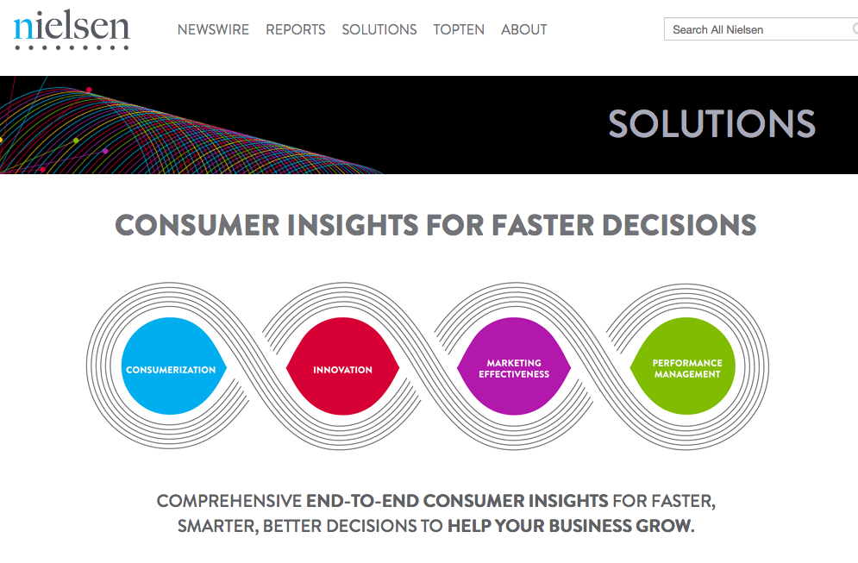
Information Brokers

Slide 31
Why OBI,OBO Foundry

